Slide 1
Arduino Interfacing
Basics to circuit design with Arduino

Slide 2
Overview
Recommended practices while taking output
Common drivers used for interfacing
Tool for designing circuit and PCB

Slide 3
Impedance Matching
5V
ARDUINO

Slide 4

Impedance Matching
ARDUINO
5V

Slide 5
Impedance Matching
DRIVER
ARDUINO
5V

Slide 6
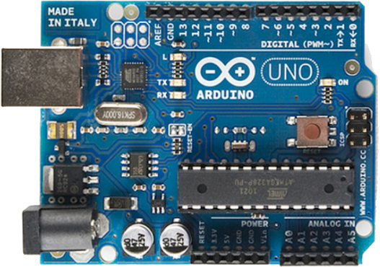
Typical Connection Diagram
+
MASTER SOURCE
Voltage Regulator
LOAD
-

Slide 7
Common Drivers
Common drivers used to interface with Arduino

Slide 8
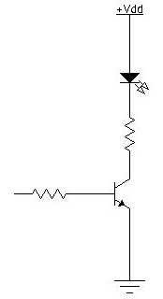
Transistor
Simplest driver circuit
Useful in driving low power loads
L
O
A
D

Slide 9
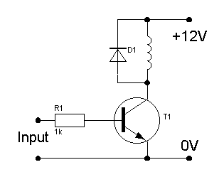
TRANSISTOR - CIRCUIT EXAMPLE

Slide 10
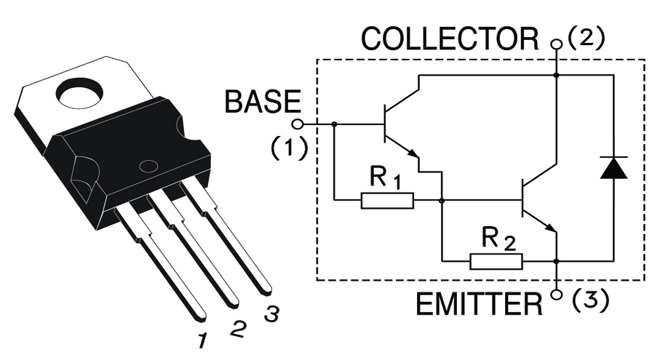
TIP122 – darlington pair
Useful in driving large current loads
Heat sink is required

Slide 11
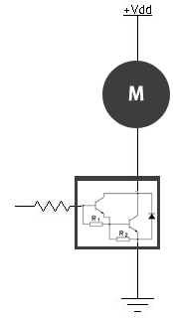
TIP122 – Circuit Example

Slide 12
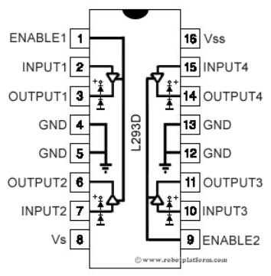
L293D
Most common motor driver
1A driving capability

Slide 13
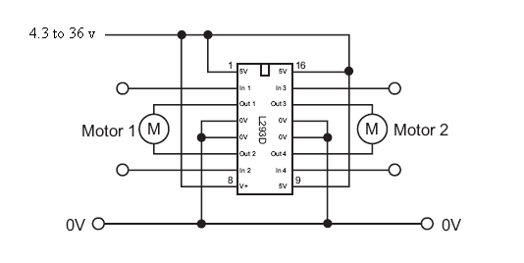
L293D

Slide 14
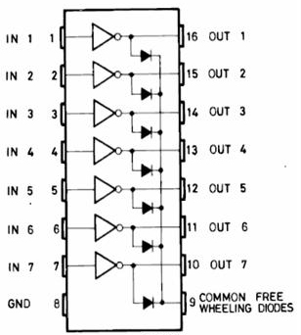
ULN2003 – realy driver
Most common relay driver

Slide 15
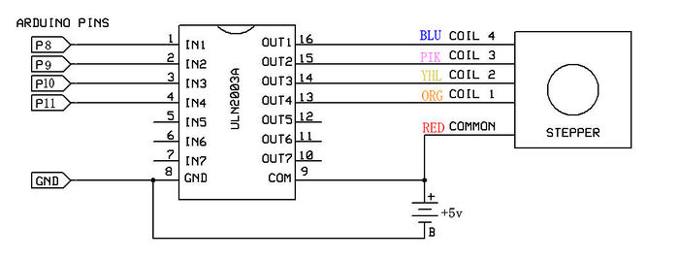
ULN2003 – circuit example

Slide 16
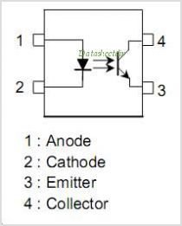
tlp421 - OPTOCOUPLER
Used where input - output isolation is required

Slide 17
ARDUINO SHIELDS
Plugins to add functionality to Arduino

Slide 18
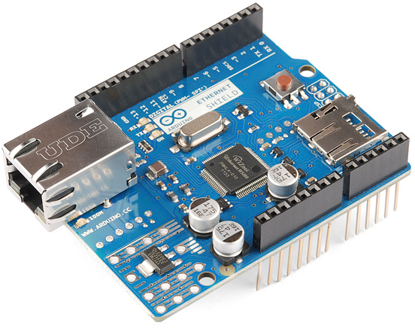
ARDUINO SHieLDS
Plugins to add include extra functionality to Arduino
Each shield has its own library which can be invoked into the sketch.

Slide 19
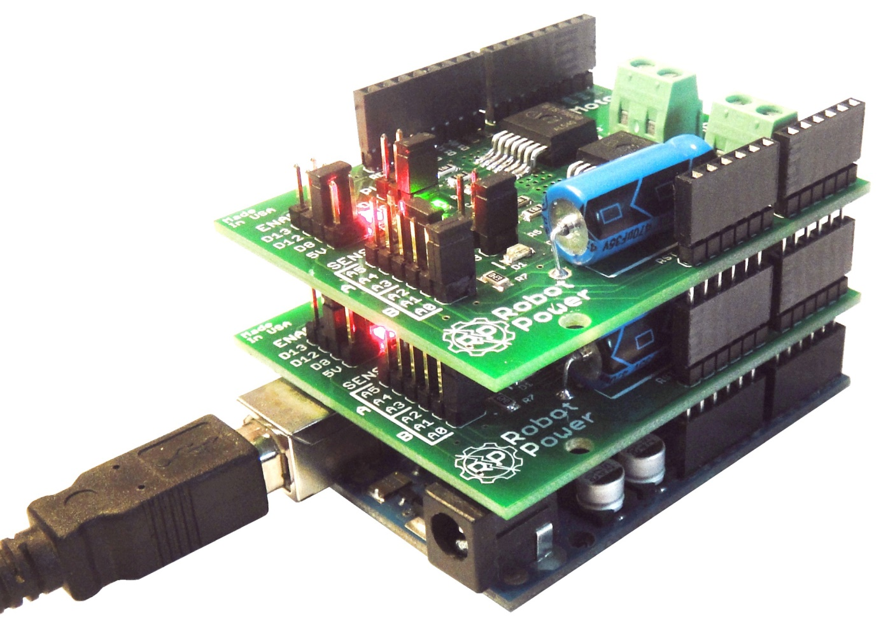
ARDUINO SHEILDS

Slide 20
Circuit design tool

Slide 21

EAGLE
Easily Applicable Graphical Layout Editor

Slide 22
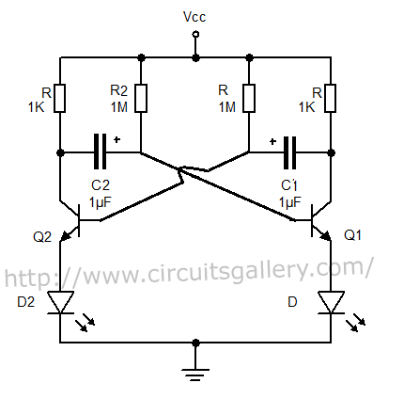
TASK ?

